Slide 1

STRUCTURED STREAMING OF SENSOR DATA
Leveraging IoT and Real-Time. Data Processing
Francesco Frusone – 05/10/2023

Slide 2
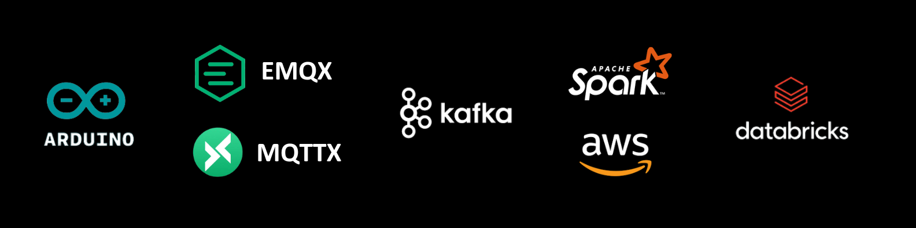
OVERVIEW
The integration of sensor data into a real-time data processing pipelines enables organizations to rapidly respond to changing conditions, make data-driven decisions, and extract valuable insights.
This project consist in the creation of a pipeline for the flow of sensor data from an Arduino console to a Databricks Delta Table, where a Spark cluster can be used for real-time data processing and analysis.

Slide 3
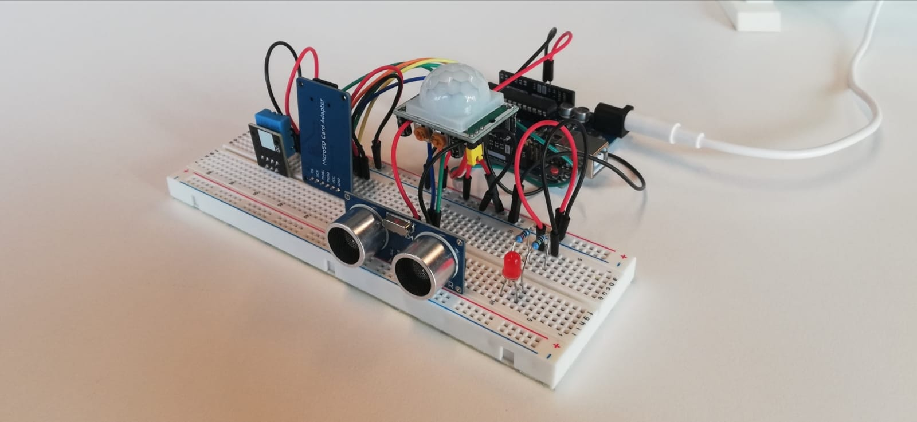
ARDUINO
Arduino is an open-source electronics platform that consists of both hardware and software components, designed for creating interactive and programmable electronic projects.
Sensors used:
DHT11: for temperature and humidity observations
SR04: sonar sensor for high frequency measuring of the nearest object distance
PIR: Passive Infra-Red sensor for movement detection

Slide 4
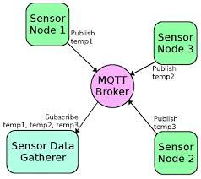
EMQX & MQTTX
The EMQX Cloud service served as a link between the Arduino and the Kafka Server, thanks to the Data Bridge to Kafka feature.
The MQTTX client toolbox for desktop helped to test the established connection with the Kafka server.
MQTT is a lightweight, publish-subscribe, machine to machine network protocol for message queuing service.
EMQX is an open-source, distributed MQTT messaging broker that can support millions of concurrent MQTT connections.

Slide 5
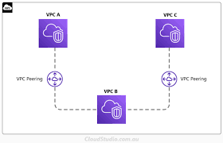
KAFKA & AWS
Kafka is an open-source distributed event streaming platform that allows real-time data ingestion, processing, and distribution across applications and systems.
AWS served as the Cloud Service Provider for the Databricks environment, for the EMQX Cloud service and for the Kafka Server (Kafka was installed to an EC2 instance through an SSH connection).
The three resulting VPC where then Peer Connected so that the respective compute instances could seamlessly communicate with one another using their private IPs.

Slide 6
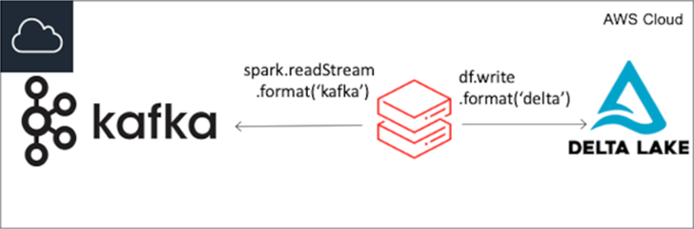
SPARK & DATABRICKS
Databricks is a comprehensive, cloud-based (AWS) data analytics and machine learning platform that offers the scalability and automation needed to handle complex data workflows.
Spark is an open-source unified analytics engine for large-scale data processing.
Spark allowed the start of read and write streams that listened to the messages in the different Kafka topics and recorded the values to a Delta Table, in which the data was finally stored.

Slide 7

THE END

